Slide 1

Prediction of Airline Reporting Carrier On-Time Performance
By Amulya Gunturu, Anusha Arjun Ganesh, and Yogesh Prabhakar

Slide 2
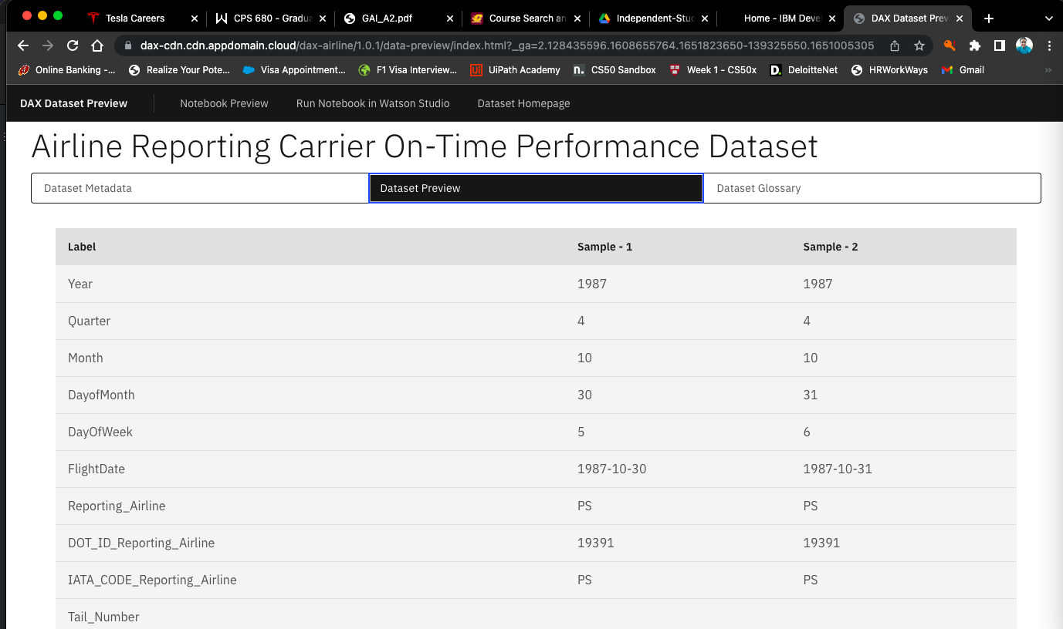
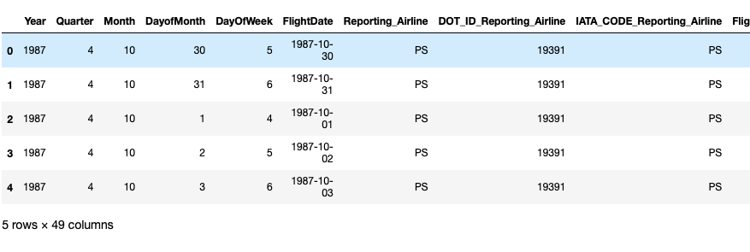
Dataset
Dataset is accessed from https://developer.ibm.com/exchanges/data/all/airline/

Slide 3
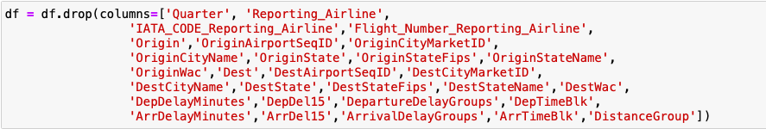
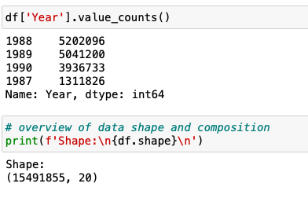
Data Wrangling
Dropping the columns with repeated information, duplicates.

Slide 4
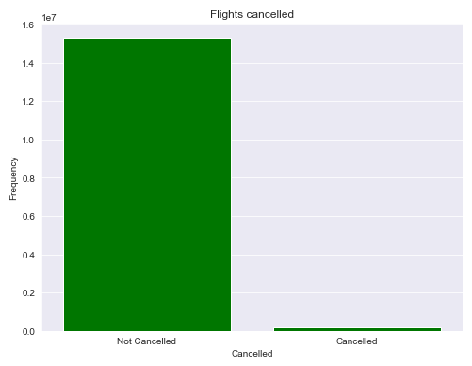
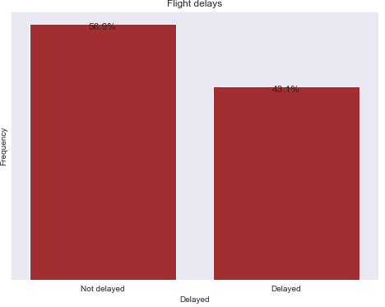
Uni-variate Analysis

Slide 5
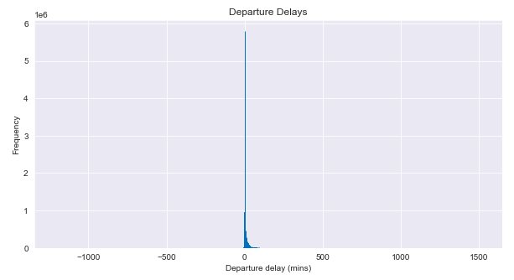
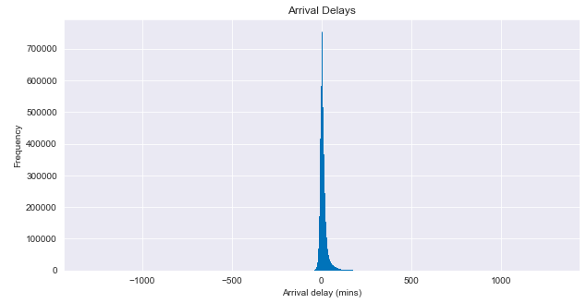
Uni-variate Analysis

Slide 6
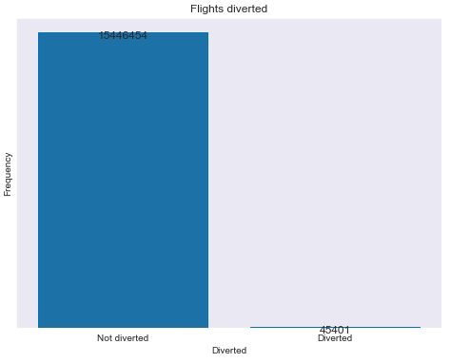
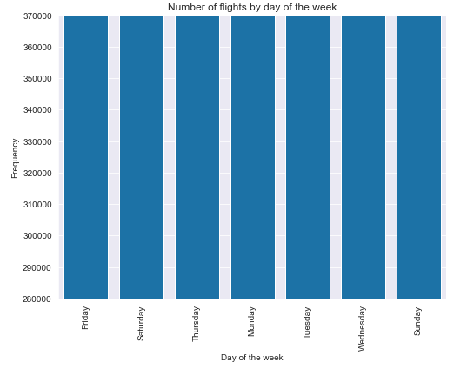
Uni-variate Analysis

Slide 7
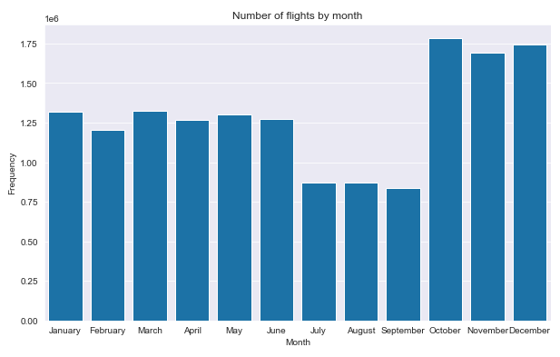
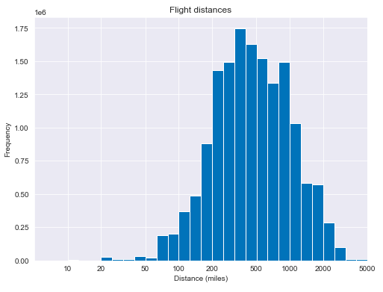
Uni-variate Analysis

Slide 8
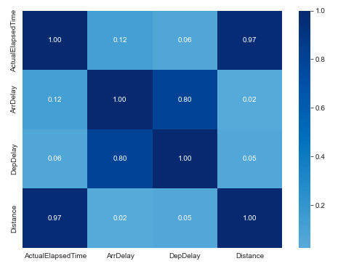
Bi-variate Analysis

Slide 9
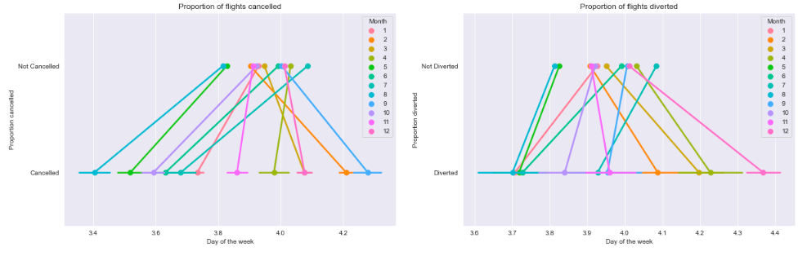
Multi-variate Analysis

Slide 10
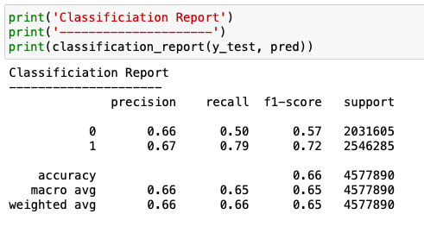
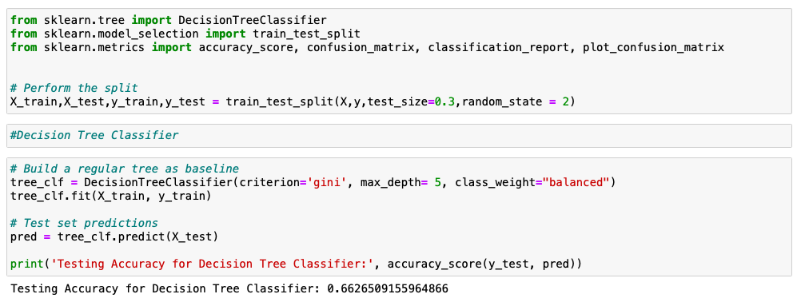
Machine learning model
Decision Tree Classifier

Slide 11


